Slide 2
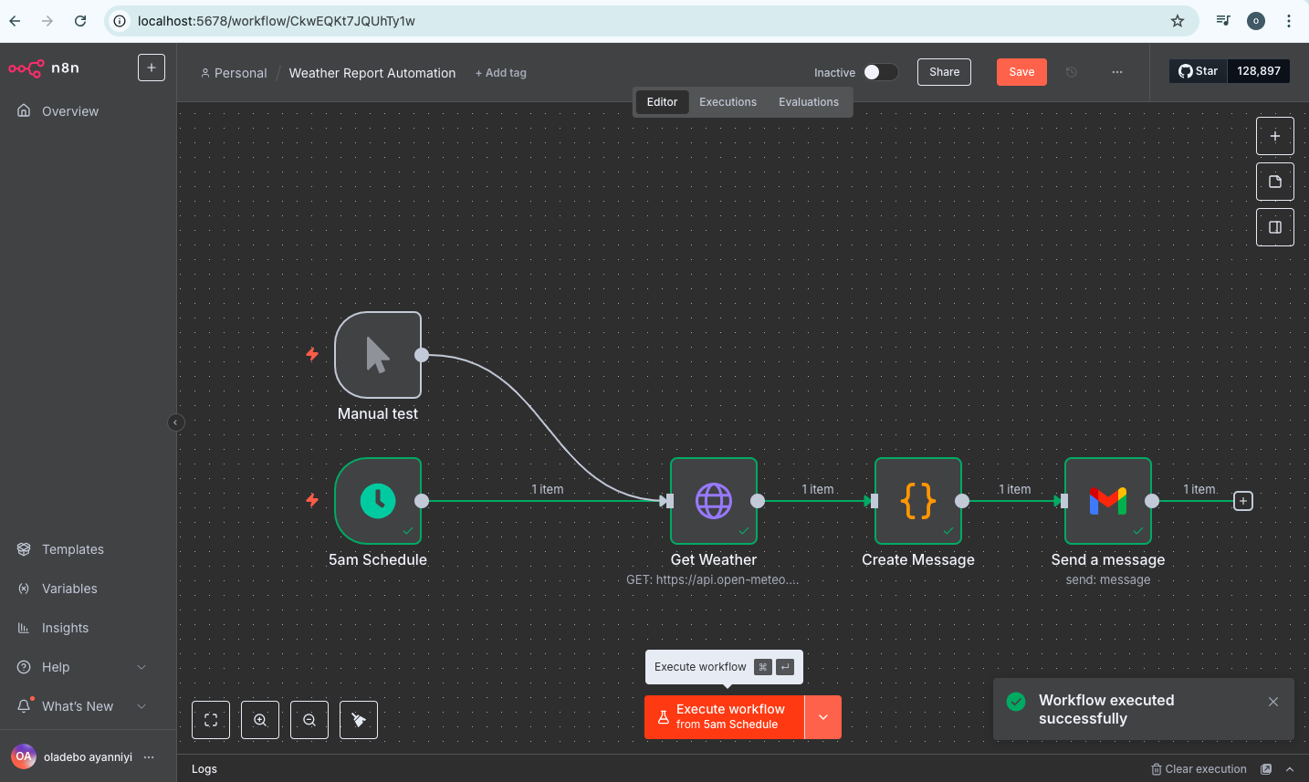
Weather Automation Report Project
https://github.com/oladebo/AI-Automation-Weather-Reports

Slide 3
Content
Content:
Project Overview
Situation and background
n8n Objectives/Introduction
Identify problem(s) or opportunity
Benefit of using n8n
State hypothesis
Concept of Automation And AI Agent
Free tools to use and discuss impact
Our first weather automation
Executive Summary
Conclusion

Slide 4
Project Overview
Situation and background purpose
What is n8n:
n8n is an open-source, low-code/no-code workflow automation tool that allows users to connect apps, APIs, and services to automate tasks without extensive coding.

Slide 5
n8n Objectives
Situation and background purpose
n8n aims to reduce manual work, eliminate vendor lock-in, and empower users to build automations without relying on closed platforms.
Use Case:
Automate repetitive tasks (e.g., data sync, notifications).
Connect APIs & databases (e.g., CRM, ERP, email marketing
Build custom business logic (e.g., approval workflows, chatbots)

Slide 6
Feature of n8n
Situation and background purpose
Key Features:
1. Workflow Automation : Create complex workflows using a visual drag-and-drop editor. 2. Self-Hosted & Cloud: Run it on your own server or use n8n.cloud. 3. 300+ Integrations: Supports apps like Slack, Google Sheets, GitHub, and more. 4. Custom Logic: Add JavaScript/Python for advanced automation. 5. Fair-Code License: Free to use, modify, and self-host (with some restrictions on commercial cloud use).

Slide 7
Benefit of using n8n
Situation and background purpose
Self-Hosted & Data Privacy:
Run workflows on your own servers, keeping sensitive data secure you can build agent that can perform task while you sleep
Cost-Effective:
Free to use (open-source) with no per-task fees ideal for startups and enterprises. i.e you can build hyper efficient workflow
Highly Customizable:
Add JavaScript/Python code for advanced logic, or use drag-and-drop for simple automations.
300+ Integration:
Connect APIs, databases, and apps (Slack, Shopify, PostgreSQL, etc.) without writing full code.
No Vendor Lock-In:
Avoid dependency on closed platforms modify and extend n8n as needed.
Scalable for Complex Workflows:
Chain multiple steps (e.g., "If X happens in CRM → update spreadsheet → notify team on Discord").
Active Community & Fair-Code License

Slide 8
Step to learn n8n
Situation and background purpose
Learn the terminology
Integrate AI into small workflows agent
Keep learning and practice by building in AI community
By building small workflows e.g Automation before AI Agent

Slide 9
Concept of Automation And AI Agent
Situation and background purpose
What is an Automation Agent: is a Integration automation (Trigger – Action – Output or Result) however An automation is pre-defined and fixed
-Trigger begin the workflow
While an Agent is adaptable and unique in situation (Trigger - AI Action – Result or Output) eg it can work in spreadsheet, databases etc
By building small workflows e.g Automation before AI Agent

Slide 10
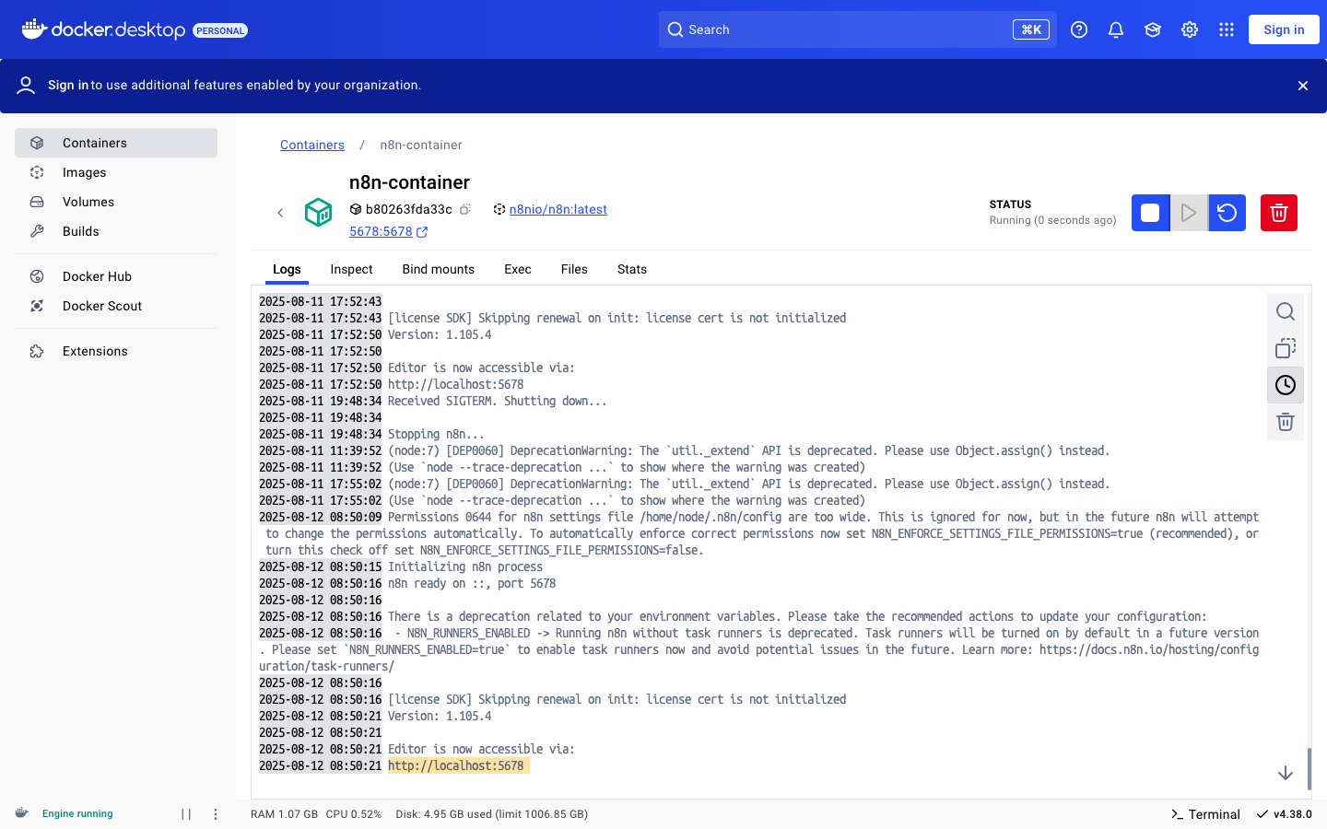
Free Tools to use
Situation and background purpose
Install Docker desktop App on your local system on docker.com on your browser and install n8n inside it either on your macbook or your window system
Create your n8n account for free or you can use the official one for 14days free trial
And click on run button up after that stroll down to copy the n8n url inside docker container and paste it on your new tab browser
Copy after you click run server inside your docker run http://localhost:5678
Googlecloud.com Account

Slide 11
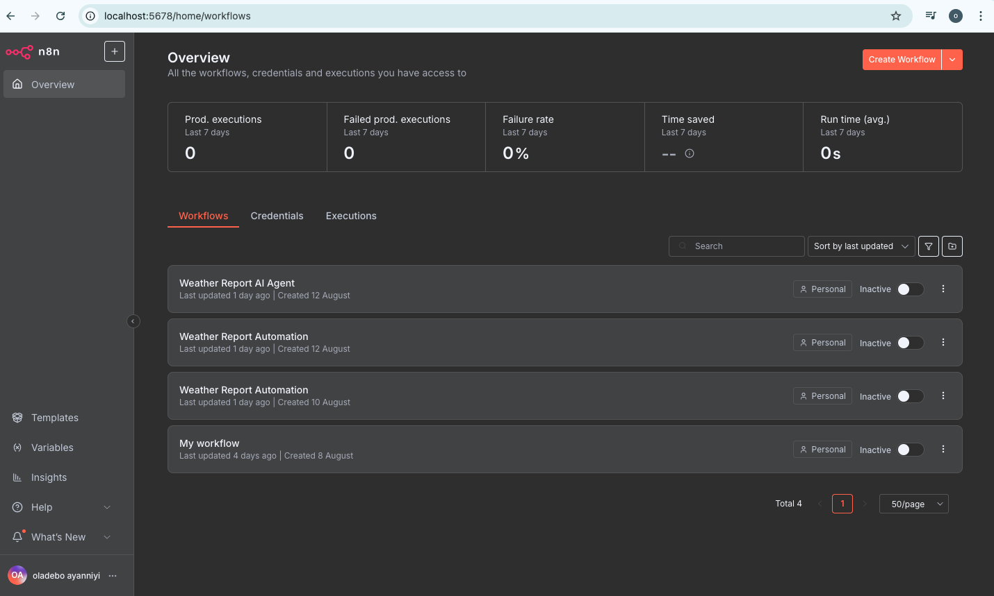
Free Tools to use
Situation and background purpose
Copy the n8n url http://localhost:5678 inside docker container and paste it on new tab on your browser
The n8n home page dashboard will display like this snap shot on your right-hand side

Slide 12
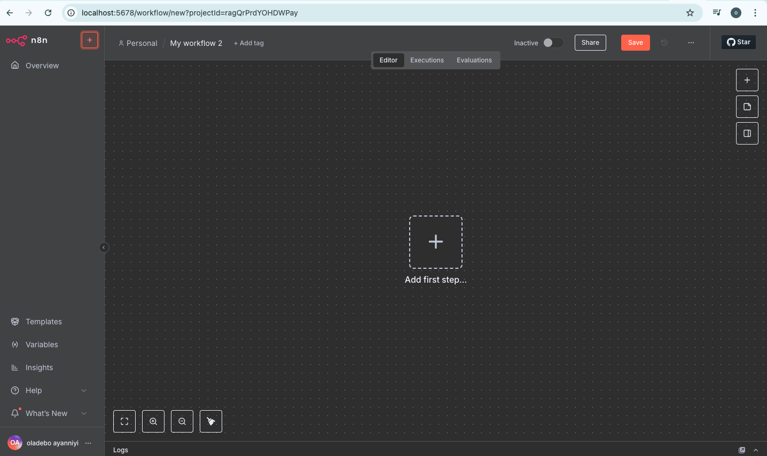
Free Tools to use
Situation and background purpose
Install Docker desktop App and install run n8n in it either on your macbook or your window system.
After that copy the n8n url inside docker container and paste it on your browser
Copy after you click on inside your docker run http://localhost:5678
The n8n home page will display
When you click on Plus (+) on the left-hand side new “My workflow” will display like this

Slide 13
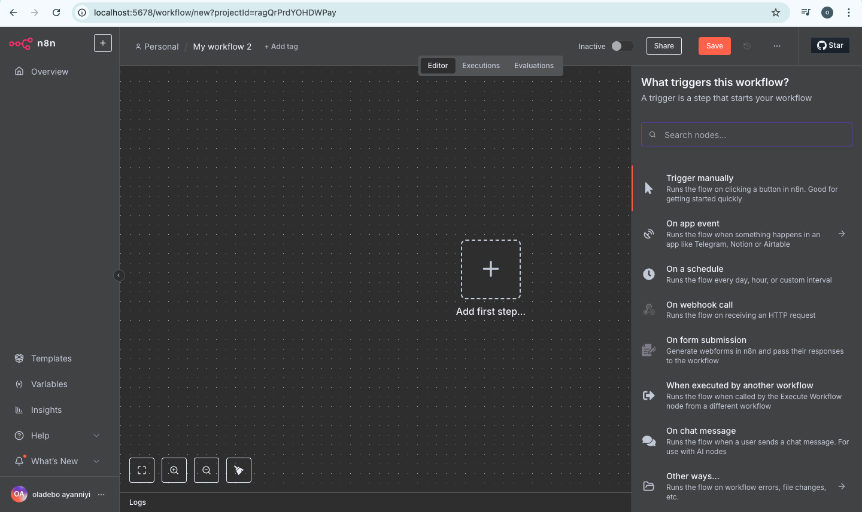
Free Tools to use
Situation and background purpose
By Clicking your (+) in the center to create your workflow automation on the first up canvan snap short .
And by navigate to the Righthandside click on (+) are called Nodes you see on the second cavan down snap short

Slide 14
Our First Weather Automation Report
Situation and background purpose
By Step 1 – Trigger Node:
Manual trigger(for Testing)
Schedule trigger that starts the automation once every 24hours
By Step 2 Action Node:
HTTP request to public weather data using open – meteo.com
By Step 3 – Code Node:
Transform raw data to a “Weather report Message”
And By Step 4 – Action Node:
Send myself an e-mail with the message created

Slide 15
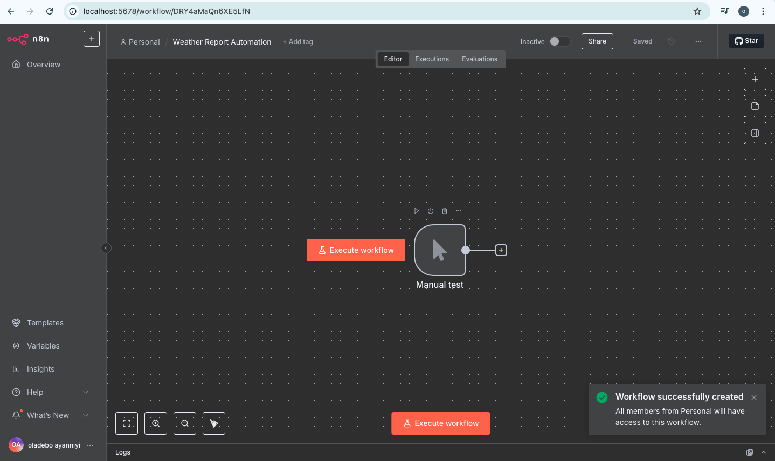
Our First Weather Automation Report
Situation and background purpose
By clicking your (+) sign in the center or right-hand side to create your workflow automation node on the canvan and click on the trigger pop-up by the right-hand side
On the second canvan under the first canvan and right click on the trigger icon and rename it to “Manual test” and also at the top rename the “Workflow” to “Weather Report Automation”

Slide 16
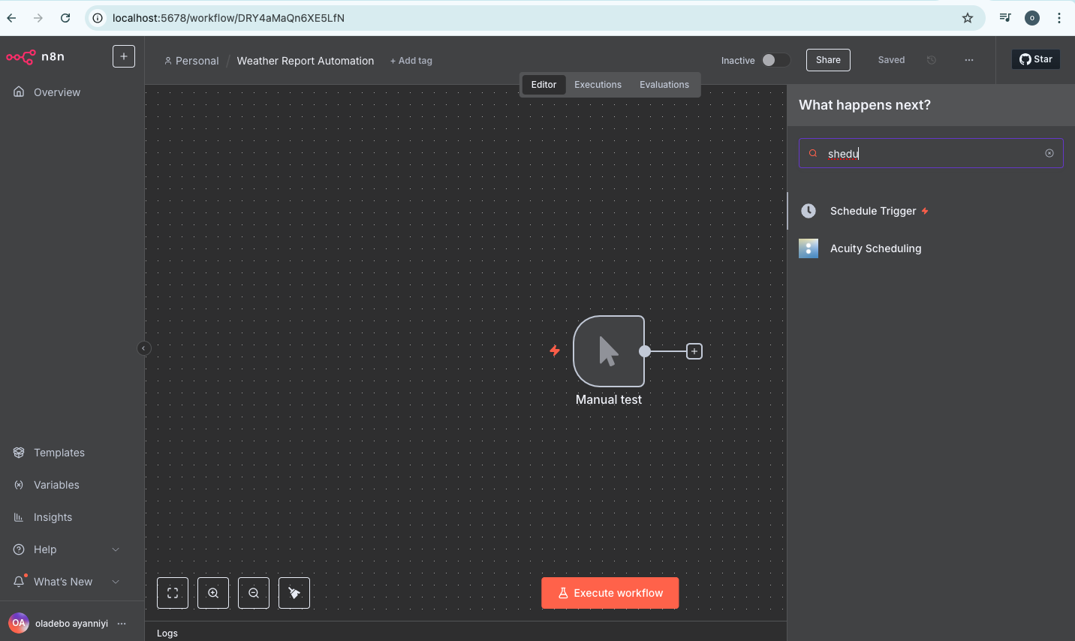
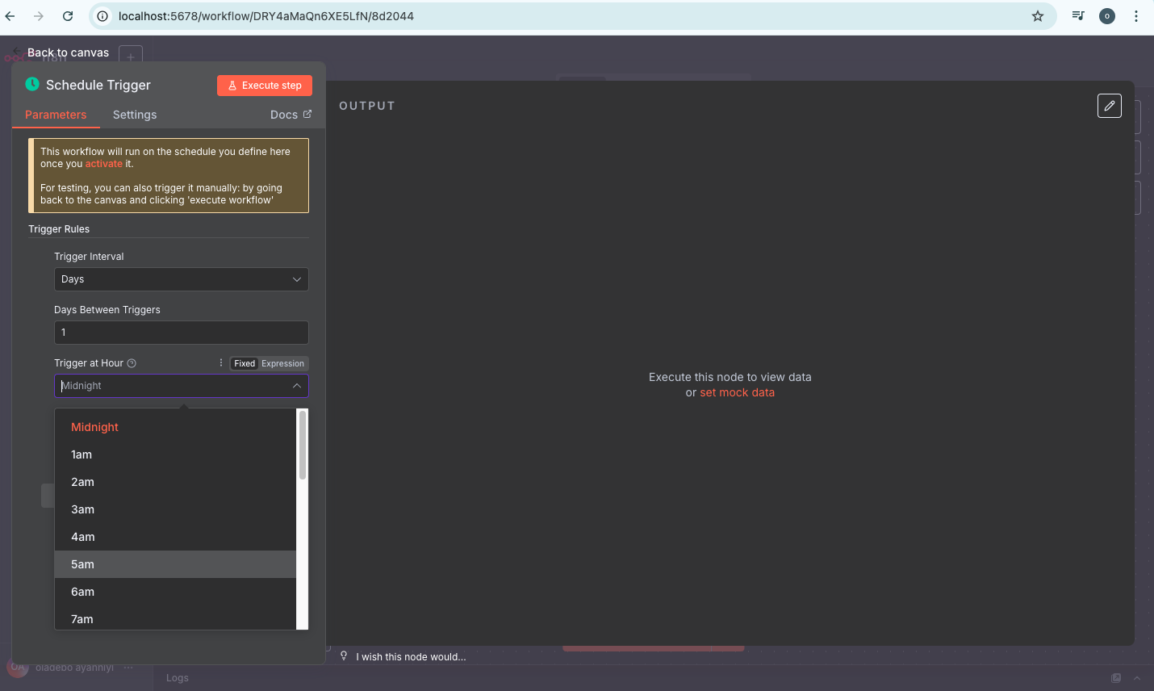
Our First Weather Automation Report
Situation and background purpose
By clicking your (+) again the node panel table will come up by the right-hand type “schedule” on search click on “Schedule Trigger” pop-up by the left-hand side to set our “trigger at hour” to “5am” as seen on the second table snap short down.

Slide 17
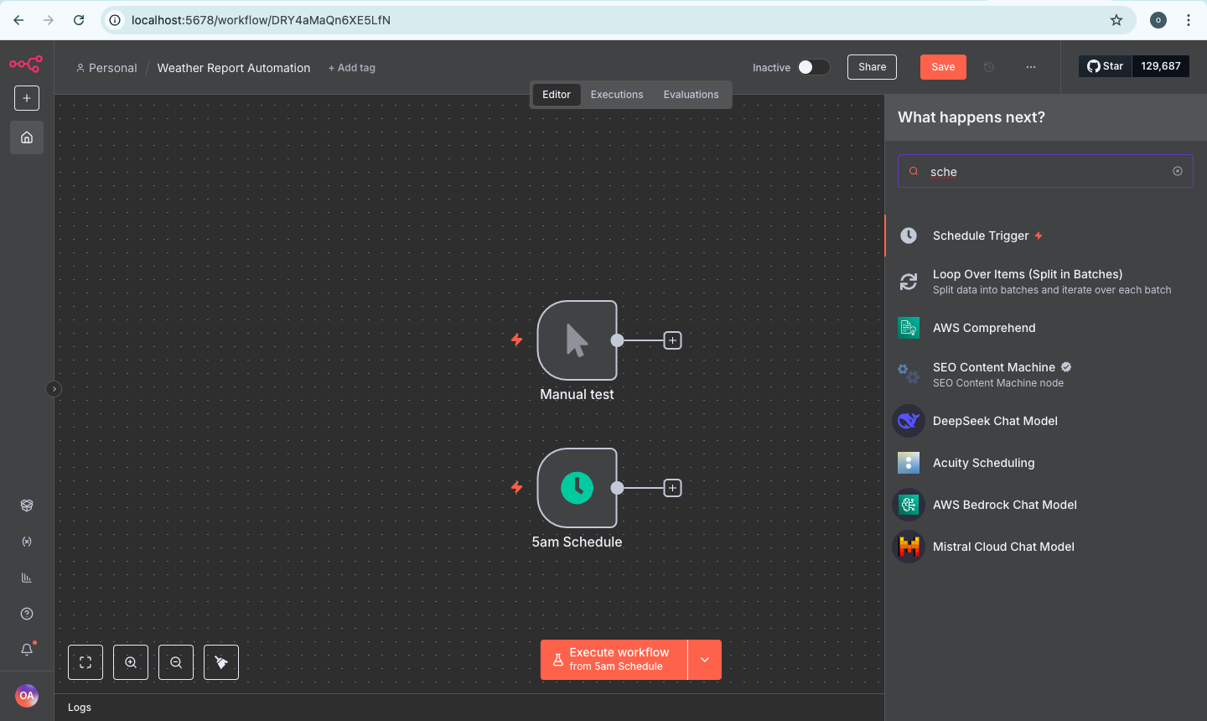
Our First Weather Automation Report
Situation and background purpose
After setting the “Schedule trigger hour” to “5am” and rename the schedule to “5am Schedule”
And close the navigator panel bar side on the left-hand so that we can create nice space view in the canvan

Slide 18
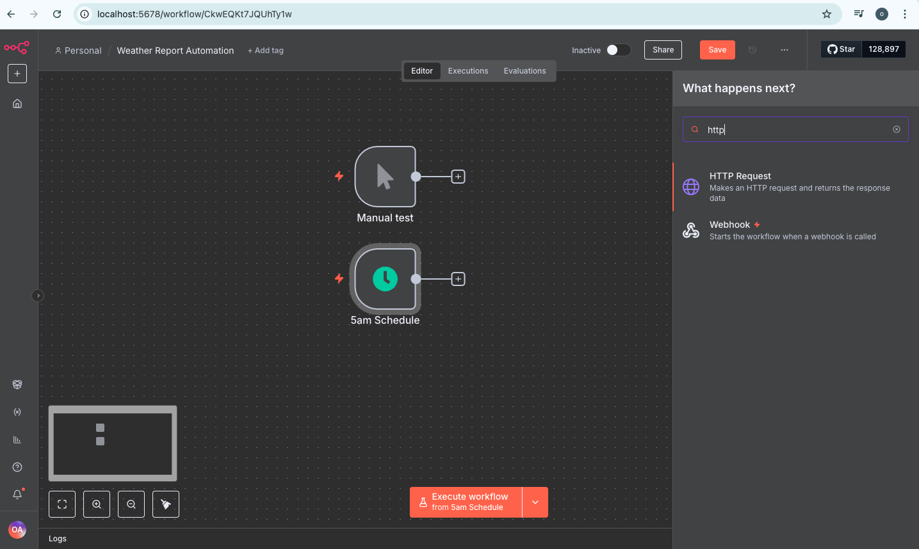
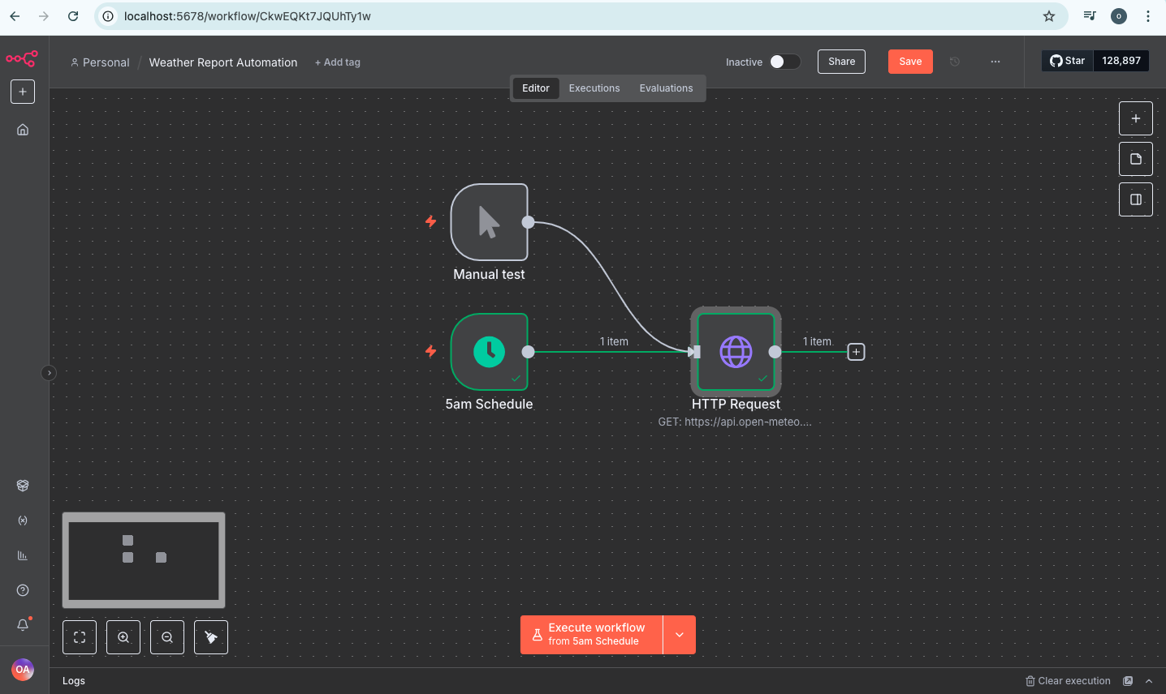
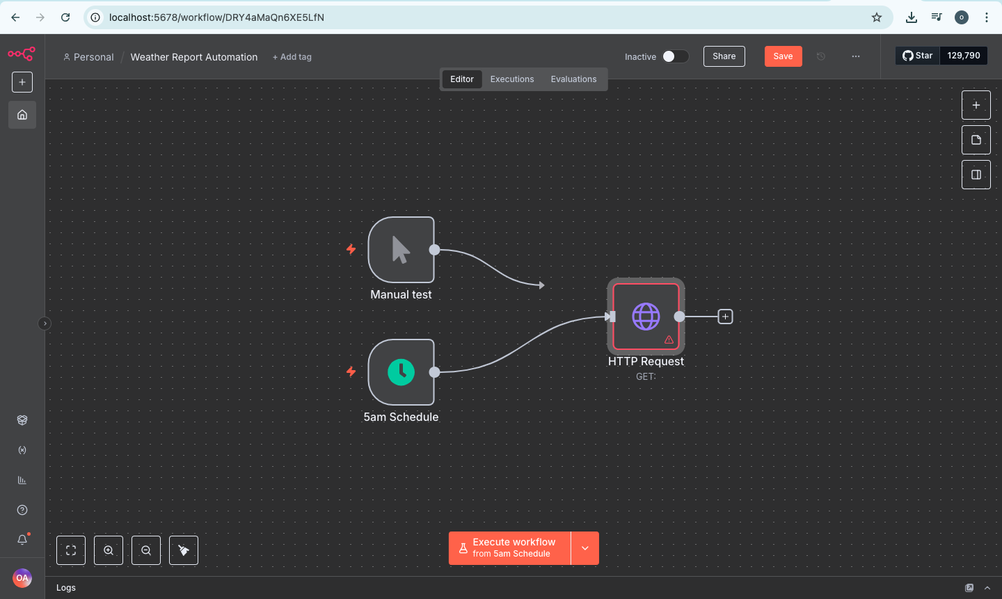
Our First Weather Automation Report
Situation and background purpose
By clicking your (+) again the node panel will come up by the right-hand type “HTTP” on search click on “HTTP Request” pop-up by the left-hand side as seen on the second table snap short down. To connect the two we need to drag the (+) button to join the from one node to other “HTTP Request” node as see below

Slide 19
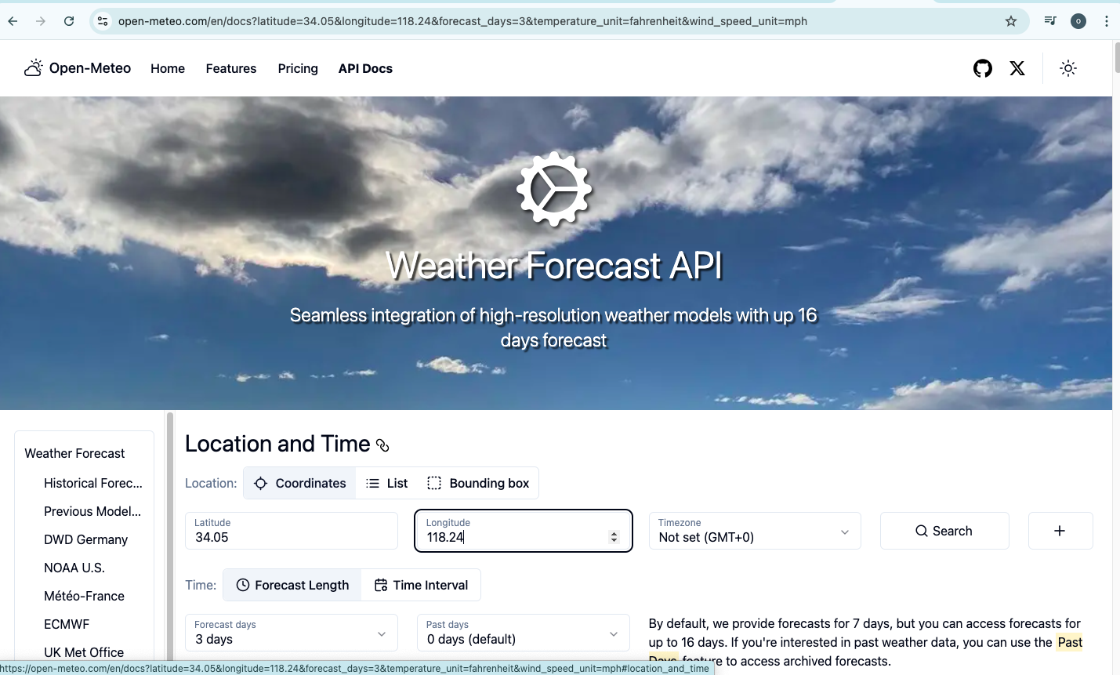
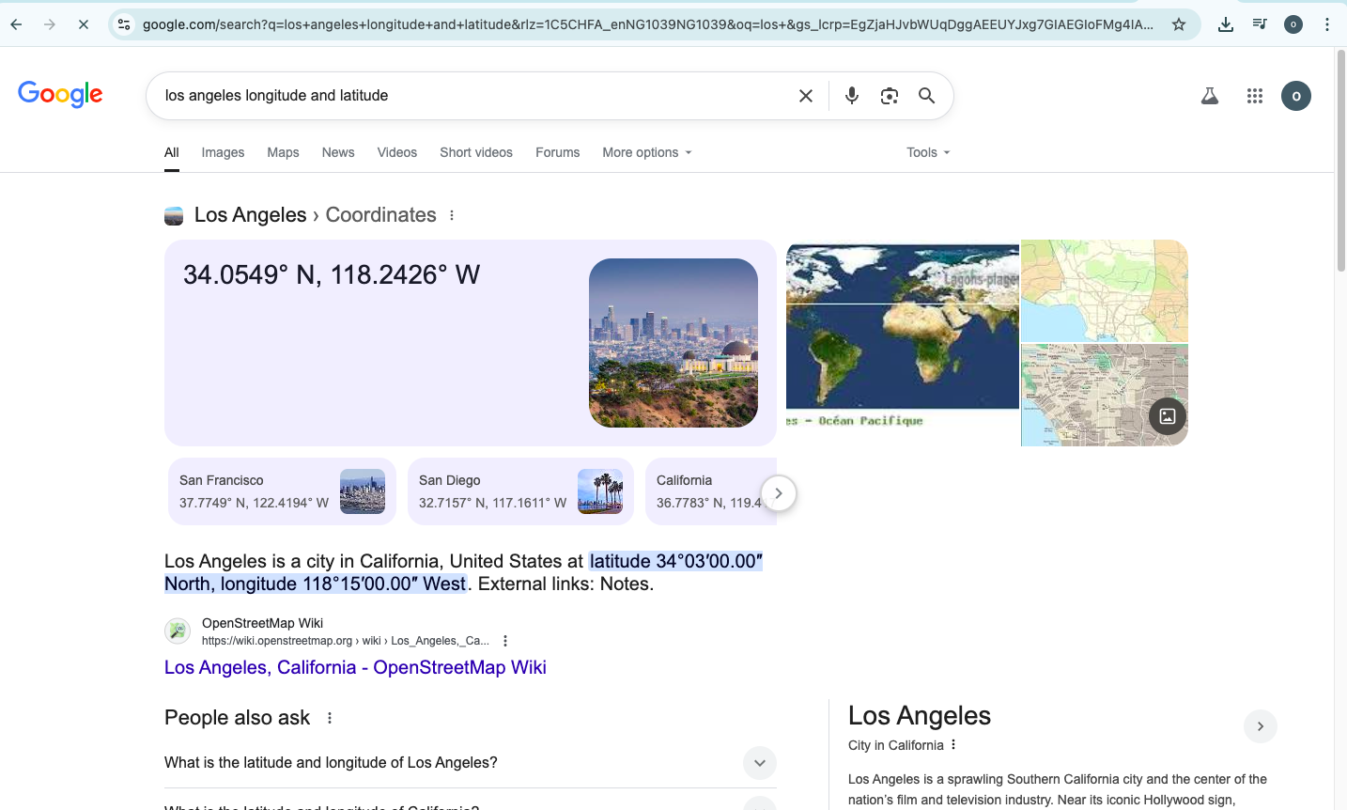
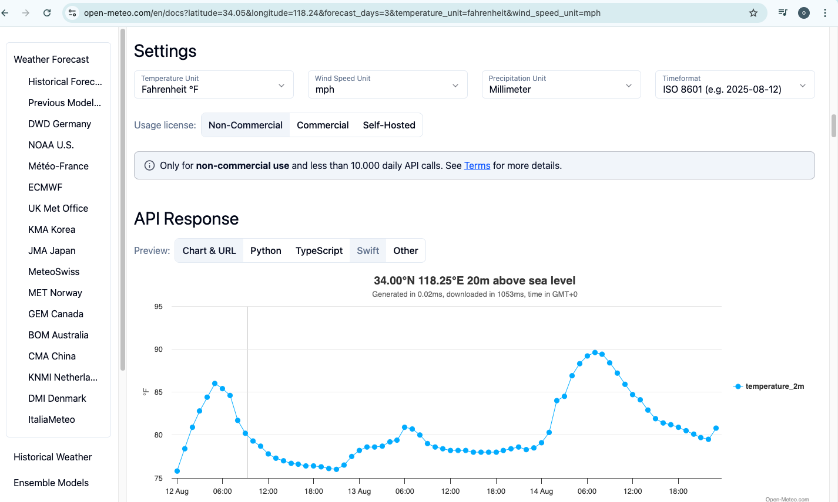
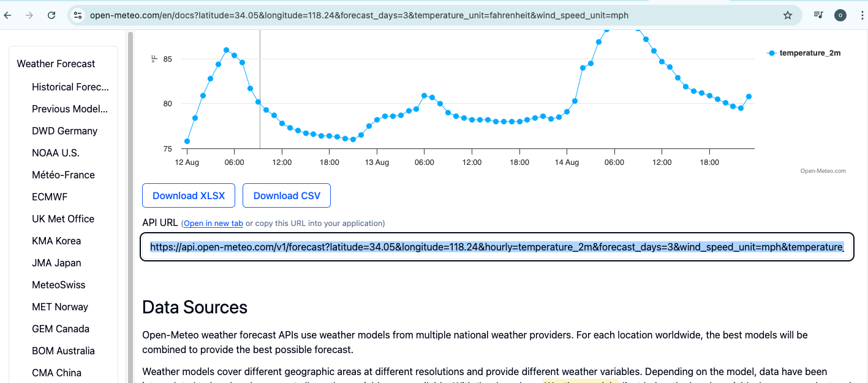
Our First Weather Automation Report
Situation and background purpose
To get the Weather API for specific location we need to use this free open-meteo.com to connect our URL “HTTP Request” weather report data from open-meteo.com to create special Url to provide the information about the weather
Go to open-meteo.com & click on “API Docs” and stroll to location & time to change the longitude & latitude to Los Angeles “34.05 and 118.24”
Go to new tab on browser and type specific weather location & time we want e.g “Los Angeles longitude/latitude” as seen on snap shot on the right“
Go to setting to change temperature from Celsius to Fahrenheit from the drop-down, Wind speed unit to (mph) & stroll down to copy the “API URL” https://api.open-meteo.com/v1/forecast?latitude=34.05&longitude=118.24&hourly=temperature_2m&forecast_days=3&wind_speed_unit=mph&temperature as seen on the right snap shot

Slide 20
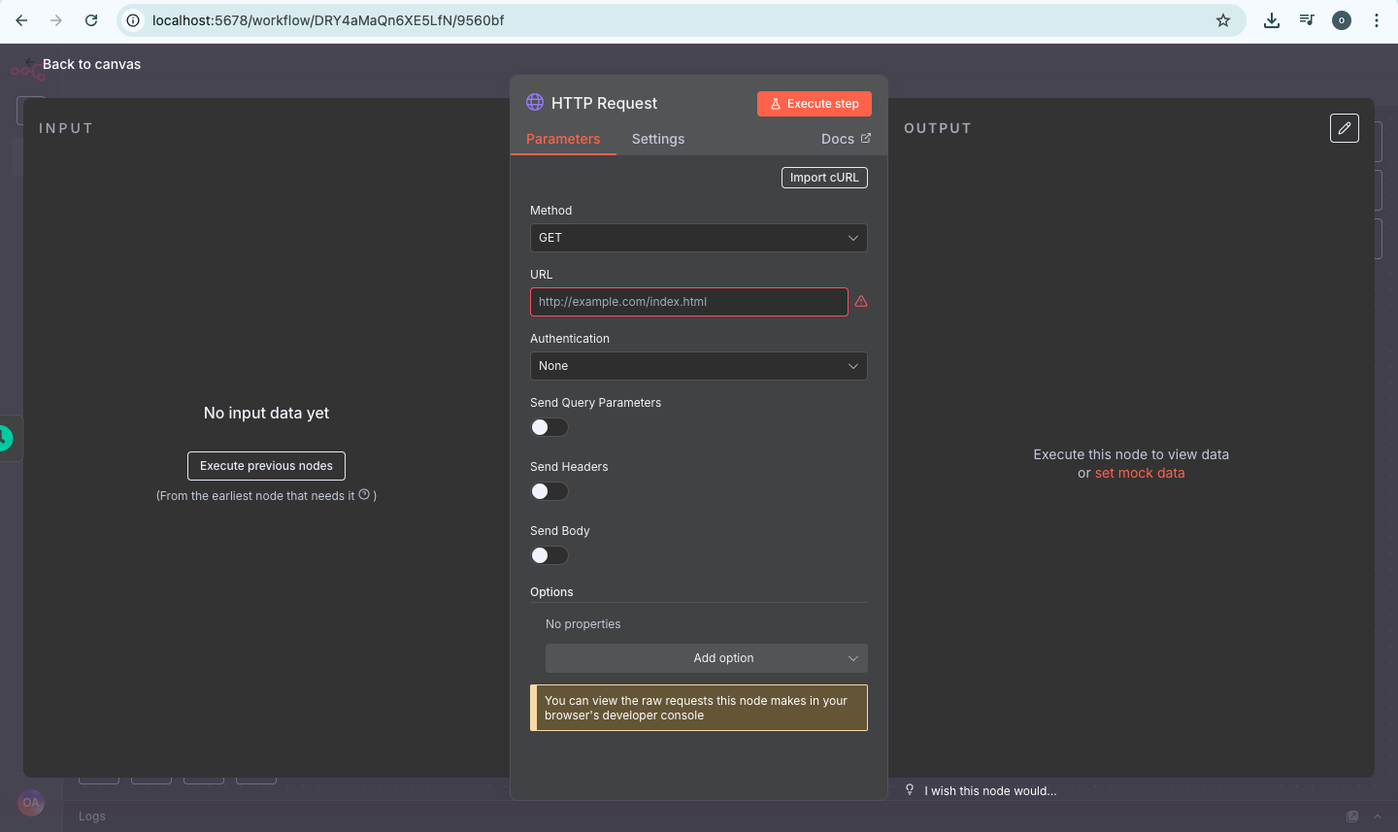
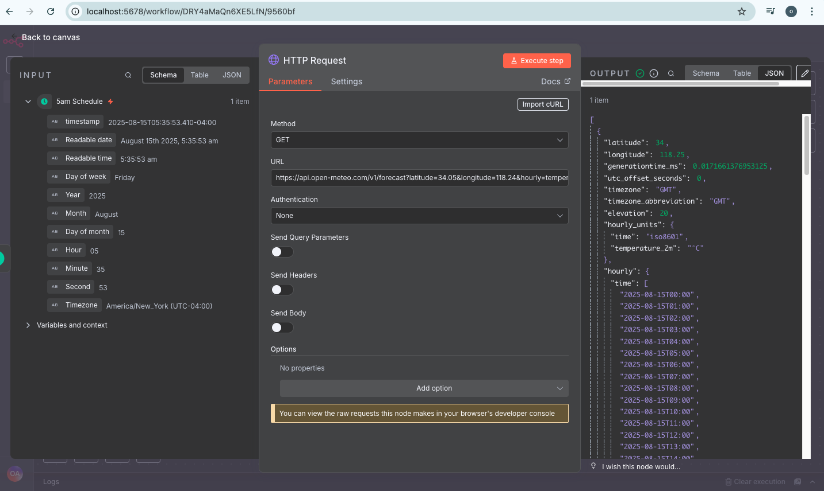
Our First Weather Automation Report
Situation and background purpose
By double click our HTTP Request node above the HTTP table will appear in between input and output as seen on the first snap shot on the right-handside
Leave the Method as “GET” & fill in the URL HTTP by copy the “API URL” from open-meteo.com Api Doc & past on the our “HTTP Request URL” box as you can see on the second table on the right
Go to the top to click on “Executive step” to see the input data on the left and output script in Json code HTTP format on the right-handside.

Slide 21
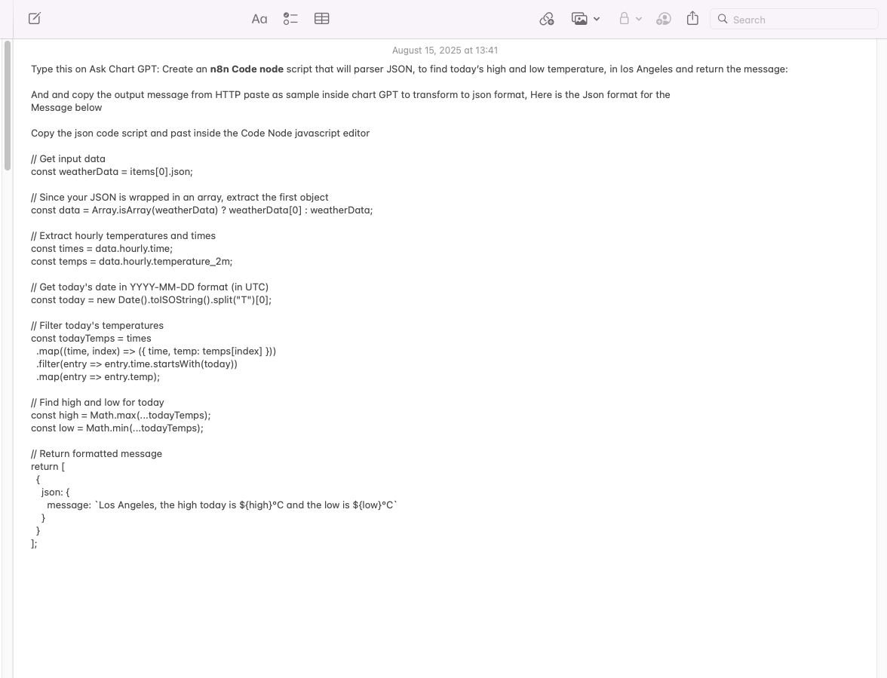
Our First Weather Automation Report
Situation and background purpose
Copy output HTTP code on the right as seen on the first snap shot on the right
And past HTTP code inside Chat GPT to use as format & ask Chat gpt to transform to Json code, however see the snap for prompt to ask chat gpt and json code chat gpt provide on the second snap shot down on the right

Slide 22
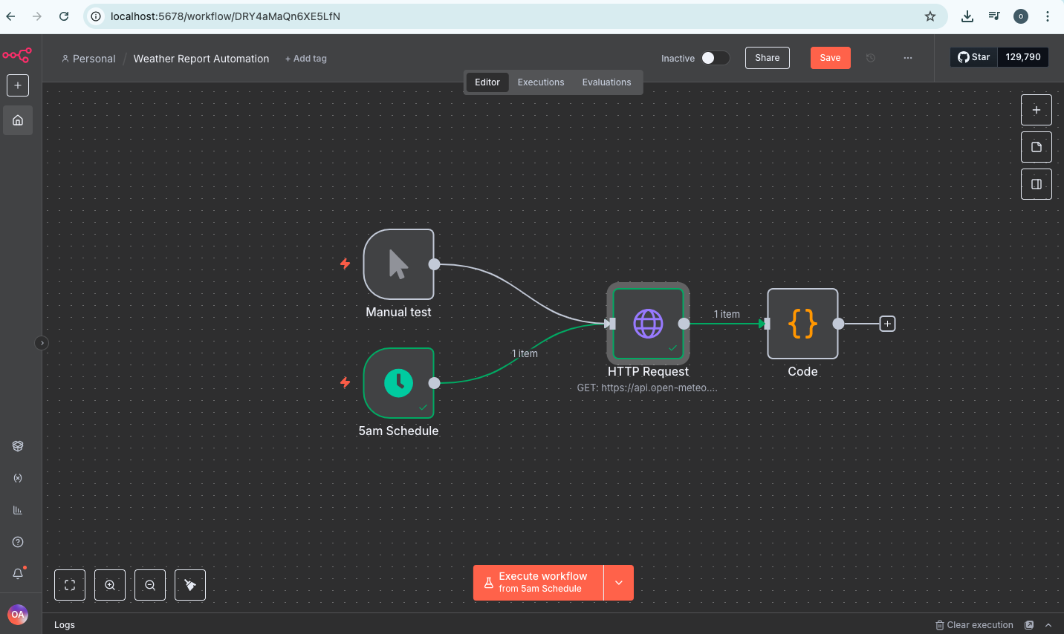
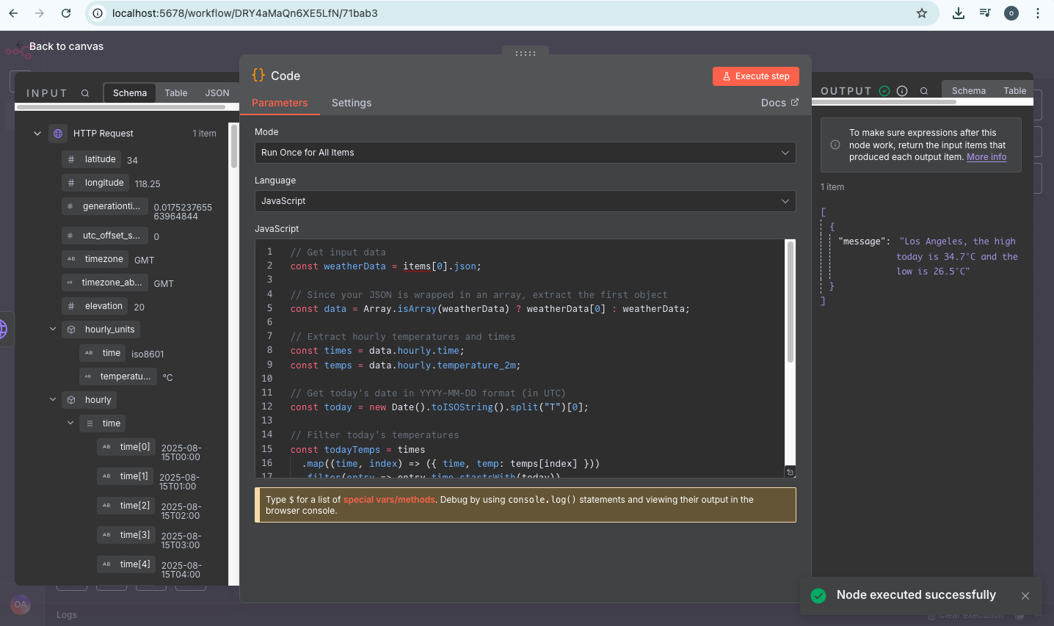
Our First Weather Automation Report
Situation and background purpose
Double click on the code node top on the righthand side as seen in snap shot
And paste the json code inside the Javascript editor in between input and output and go to the top right click “Executive step”
On the right corner you will see output message of the weather report display as seen

Slide 23
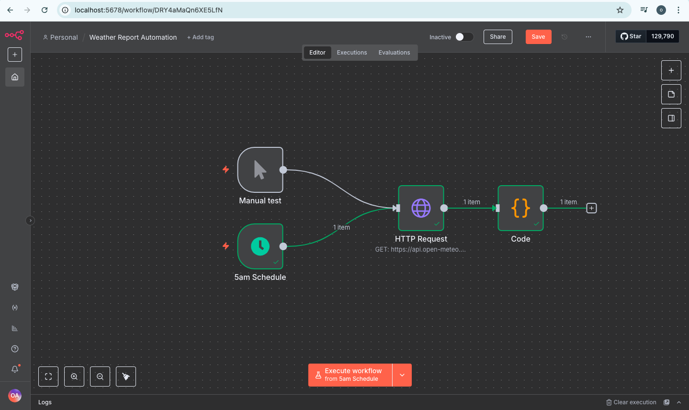
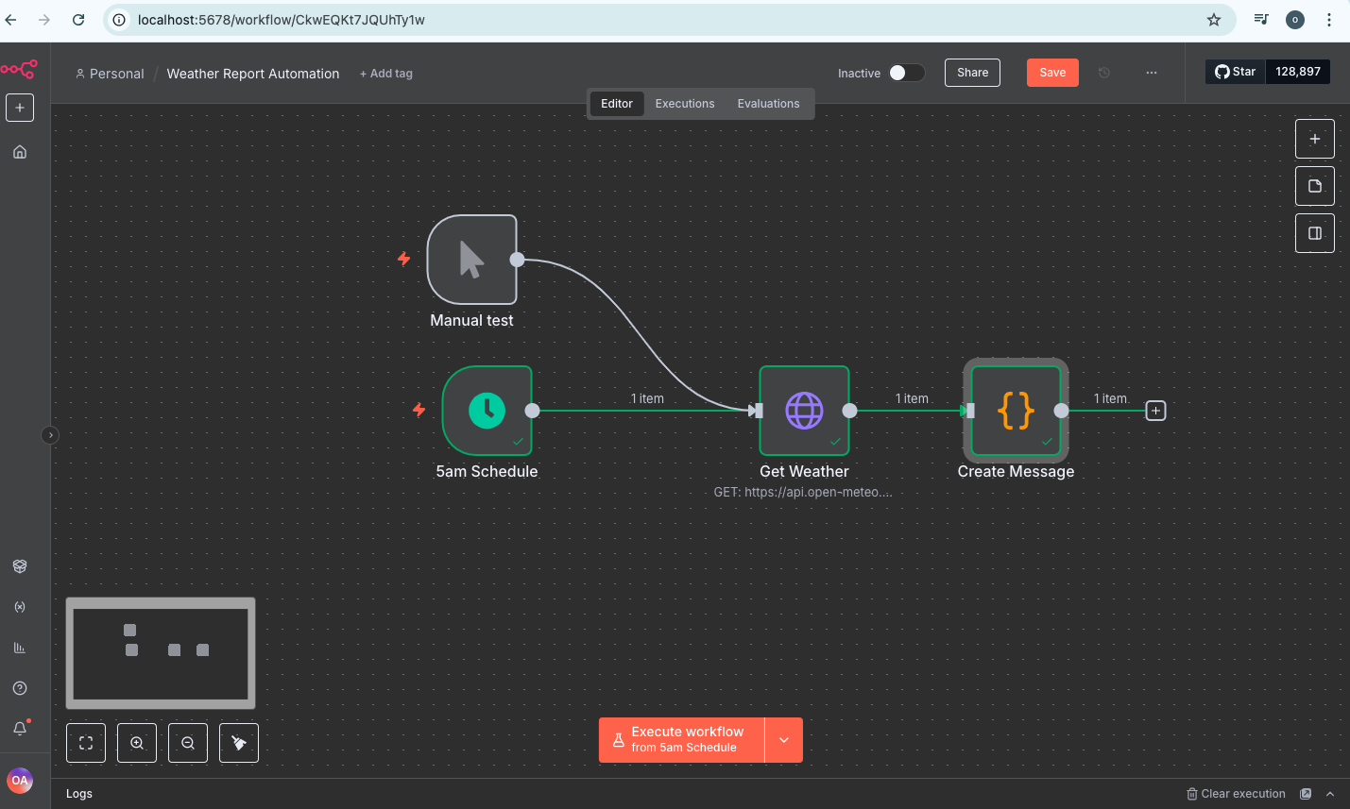
Our First Weather Automation Report
Situation and background purpose
Let clean up by rename “HTTP Request node” to “Get Weather” and also rename Code node to “Create Message” as you can see on the snap shot

Slide 24
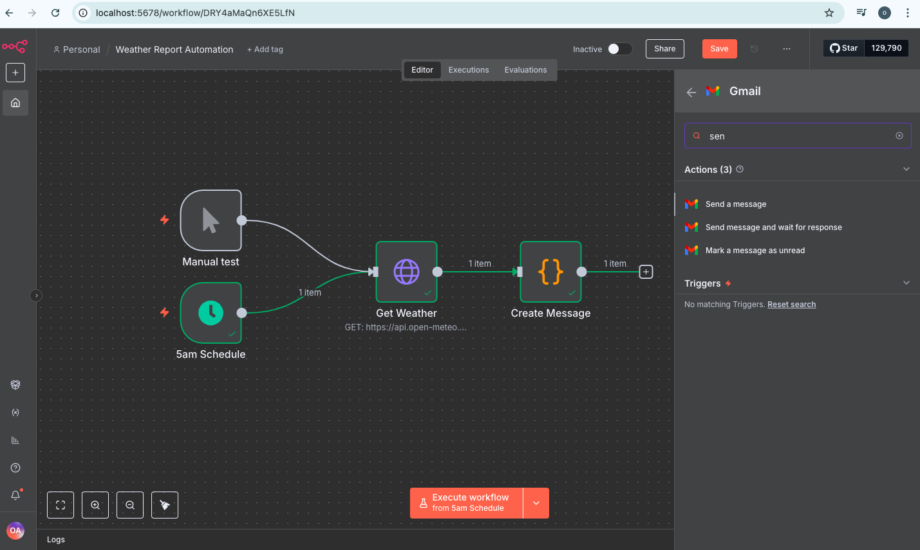
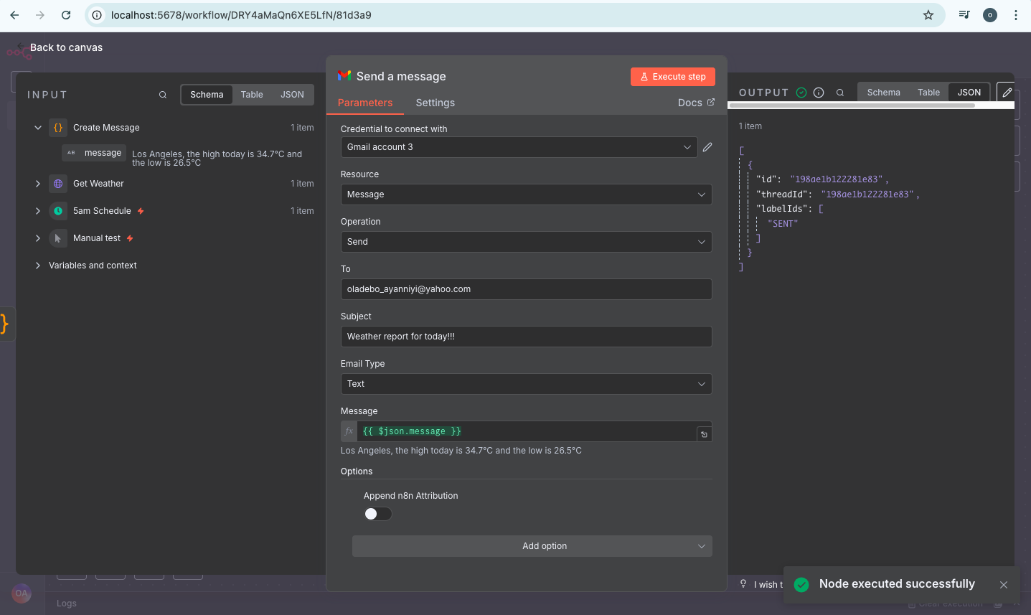
Our First Weather Automation Report
Situation and background purpose
Click the (+) button on get message node & type “Gmail” on the trigger panel on the right search stroll down to pick “Send message”
Select “Send a Message” table action schedule will appear under the parameter, click on the arrow “Credential to connect”
Stroll down to “Create Credential” to connect your Gmail account with your Gmail account through googlecloud.com. However have create mine as “Gmail account 3” & connected which I selected
Go “To” i.e where you want the email to go to, am sending to my second email address yahoomail account i.e and I type email oladebo_ayanniyi@yahoo.com
“Subject” fill in with by typing” Weather Report for today!!!”
“Message” drag the message icon on your left input schema to inside “Message box”
Click on “Option” to Append n8n attribution and turn it ”off”
Go to the top to click on “Executive step” to see the output of Weather Report send to yahoo mail account on the left

Slide 25
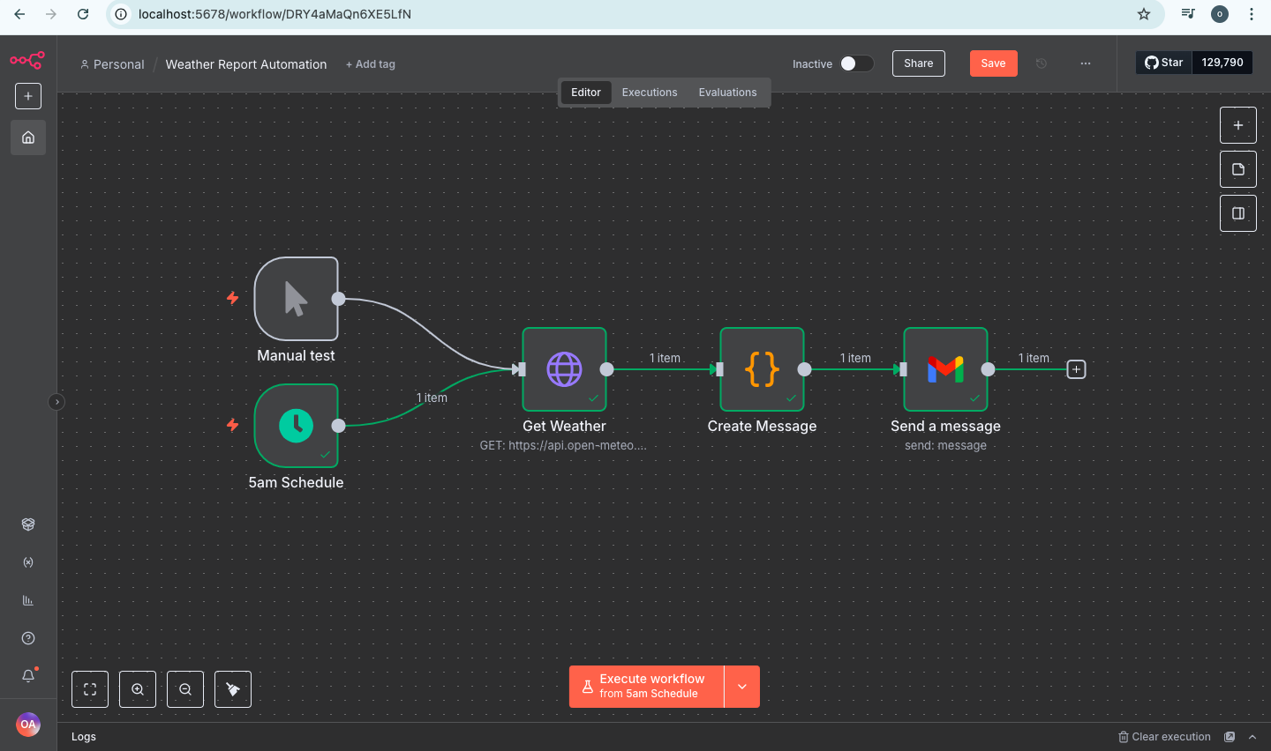
Our First Weather Automation Report
Situation and background purpose
However here is complete AI Automation on weather report project in Los Angeles
However please remember An automation is pre-defined and fixed

Slide 26
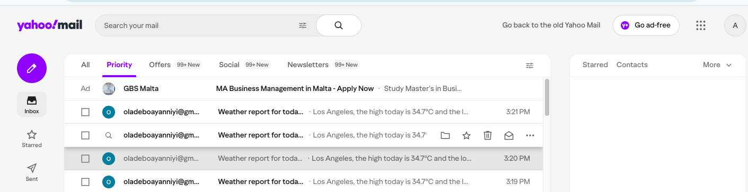
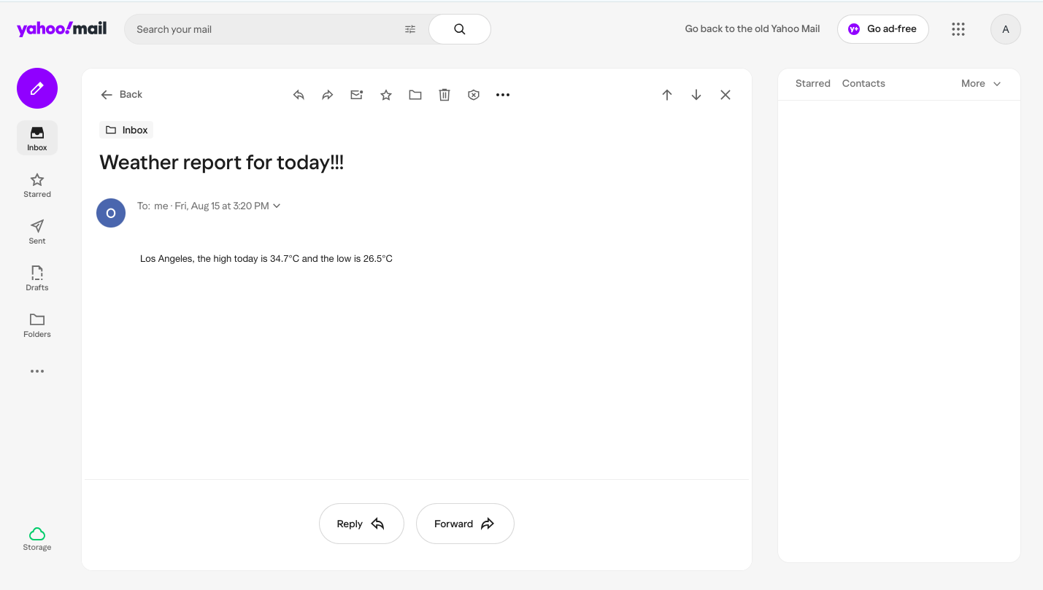
Our First Weather Automation Report
Situation and background purpose
However here is the inbox and the content of the message in my yahoomail account with send message of “Weather report for today!!!” in Los Angeles

Slide 27
Executive Summary & Conclusion
Situation and background purpose
Executive Summary
The AI-powered weather report automation project successfully streamlines the process of collecting, analyzing, and delivering accurate weather forecasts. By integrating real-time weather APIs with automated parsing, temperature range calculation, and personalized report generation, the system eliminates manual data handling and ensures consistent, timely updates. This solution provides clear, location-specific summaries such as daily highs and lows, enabling faster decision-making for both internal and external stakeholders.
Conclusion:
The automation has proven effective in improving efficiency, accuracy, and timeliness of weather reporting. By reducing human intervention, the system minimizes errors and ensures consistent delivery of insights. This project demonstrates the value of AI-driven automation in operational workflows and sets the foundation for scaling to multi-location forecasting, historical trend analysis, and integration with other decision-support systems.

